Slide 1
Enabling Multilingual Search through Controlled Vocabularies: the AGRIS Approach
Fabrizio Celli, Johannes Keizer
MTSR 2016

Slide 2
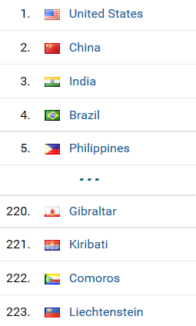
AGRIS
Bibliographic database of 8 million multilingual publications in the food and agricultural domain
350,000 visits/month from more than 200 countries and territories (Google Analytics)
Need to support cross-language information retrieval

Slide 3
Cross-language information retrieval
When a user queries AGRIS, results refer to the language of the query and of AGRIS metadata
the user query 稻米 returns all bibliographic references containing the word 稻米 in title, abstract, or as a keyword
But the user may be interested in results in all languages or in a subset of them!
Multilingual controlled vocabulary is a valid tool to deal with this scenario

Slide 4
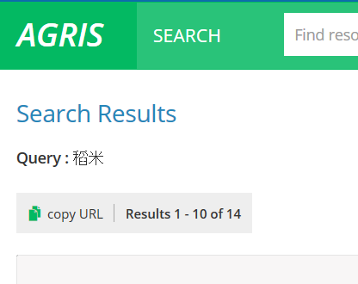
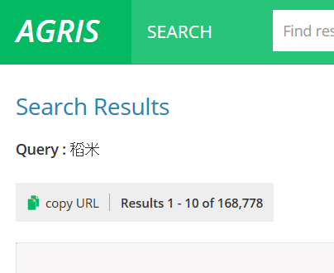
Query filters are essential to reduce the number of results after multilingual query expansion

Slide 5
Multilingual query expansion module
Given a user query, the system:
Uses AGROVOC to translate keywords
Expands the query, boosting keywords provided by the user
Returns results in all available languages
The process relies on an intermediate Solr index
It contains AGRIVOC RDF
For each concept identified by a URI, the index stores preferred and alternative labels in all languages

Slide 6
"稻米"^50 OR (“Rice" OR "चावल" OR "Reis" OR "рис" OR "ເຂົ້າ" OR "벼" OR "Arroz" OR "Riso" OR "Riz" OR "rizs" OR "rýže" OR "أرز" OR "ข้าว" OR "米" OR "ryža" OR "برنج" OR "pirinç")
稻米
Notes:
the multilingual query expansion module queries the AGROVOC label index to obtain translations of source keywords. The module matches source keywords against both preferred and alternative labels to identify the AGROVOC concept, but it considers only preferred labels as output of the translation process. In fact, alternative labels can mediate query expansion with synonyms. After that, the module expands the source query by building a union of source keywords and their translations. The system boosts source keywords by a factor of 50, since we think that it is important to return to users results of their original query first, and then results of the multilingual query.

Slide 7
Analysis of results
Correctness of results depends on the correctness of the AGROVOC thesaurus and AGRIS metadata
Source query | English translation | Number of results | Number of results of multilingual search
稻米 | rice | 14 | 166,639
फसलें | crops | 0 | 474,854
latte | milk | 8,019 | 189,475
Klimaänderung | climate change | 23 | 31,028
"su muhafazası" | water conservation | 22 | 15,285
إنتظام حراري للتربة | soil thermal regimes | 21 | 368
"forest mensuration" | forest mensuration | 3,679 | 3,930
Notes:
Correctness of results depends on the correctness of the AGROVOC thesaurus and AGRIS metadata. A community of domain experts from different countries contributes to the quality and correctness of labels available in AGROVOC. Thus, the multilingual translation based on AGROVOC is highly reliable as far as the agricultural domain concerns.

Slide 8
Performance and Usage
The execution of multilingual search requires 68.75 milliseconds more than the default search
2% of AGRIS active users enable the multilingual search
350,000 users/month
80% come from Google.com and Google Scholar
20% represent “active” users
1,400 users/month use multilingual search
Notes:
This number is quite satisfying, since multilingual search is an advanced functionality and we expect a small percentage of usage. In addition to that, the multilingual search is a new AGRIS functionality and it needs time to reach the public. It is highly likely that the percentage will increase over the time and after we will promote the multilingual search in webinars and events.

Slide 9
Synonyms Query Expansion Module
The union of preferred and alternative labels compose the set of synonyms for that language available in AGROVOC
Groundnuts: 2,824 results
Peanuts: 6,750 results
If the user searches for “Peanuts” and enables the synonyms expansion module:
9,222 results (352 records contain both “Peanuts” and “Groundnuts” )

Slide 10
Conclusions
AGRIS relies on a controlled vocabulary to implement multilingual search and synonyms expansion
Experimental results demonstrate significant improvements of recall in both cases
Future work:
Generalizing or restricting the topic of a query by navigating the hierarchy of AGROVOC concepts
Automatically performs different query expansions and combinations of them, presenting to end users alternative subsets of results

